Slide 1
Chestnut Species ID: The Basics
2012 American Chestnut Summit
Asheville, NC

Slide 2
American Chestnut (Castanea dentata)
Member of the Fagaceae family
Beech (Fagus), chestnut (Castanea) and oak (Quercus)
Species of Castanea native to north America
Castanea dentata – American chestnut
Castanea pumila – Chinquapin or Allegheny Chinquapin
Castanea ozarkensis (Castanea pumila var. ozarkensis)– Ozark Chinquapin
Non-native Castanea species
Castanea mollissima – Chinese chestnut
Castanea crenata – Japanese chestnut
Castanea sativa – European chestnut
Castanea henryi – Henry’s chinquapin (China)
Castanea seguinii – Seguin chestnut (China)

Slide 3
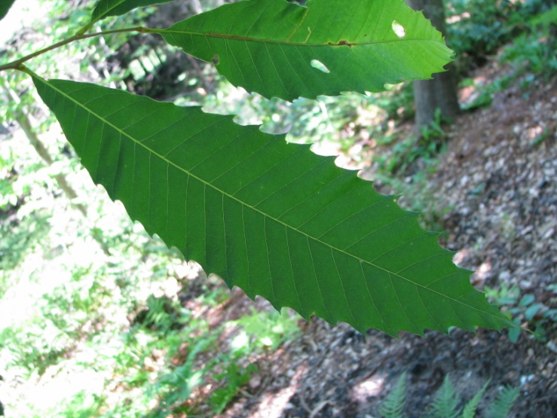
Chestnut Species You Might Find:
Native:
American chestnut (3 nuts/bur)
Allegheny chinquapin (1 nut/bur)
Imported (with recorded dates):
European chestnut (1773)
Japanese chestnut (1876)
Chinese chestnut (1912)
HYBRID CHESTNUTS
Hybridizing efforts have been recorded in the US beginning in 1895
The Connecticut Agriculture Experiment Station has been breeding chestnuts since the 1920’s
American chestnut

Slide 4

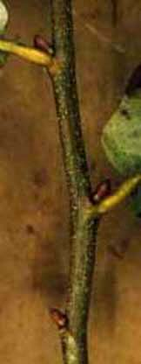
American chestnut Large, timber-form tree (at maturity)
Leaf hairless, except for sparse hairs on veins
Leaf fairly thin and papery
Leaf canoe-shaped with deeply toothed margins
Twig hairless and red to chestnut-brown
Bud smooth, and brown, pointed and usually askew on the twig

Slide 5
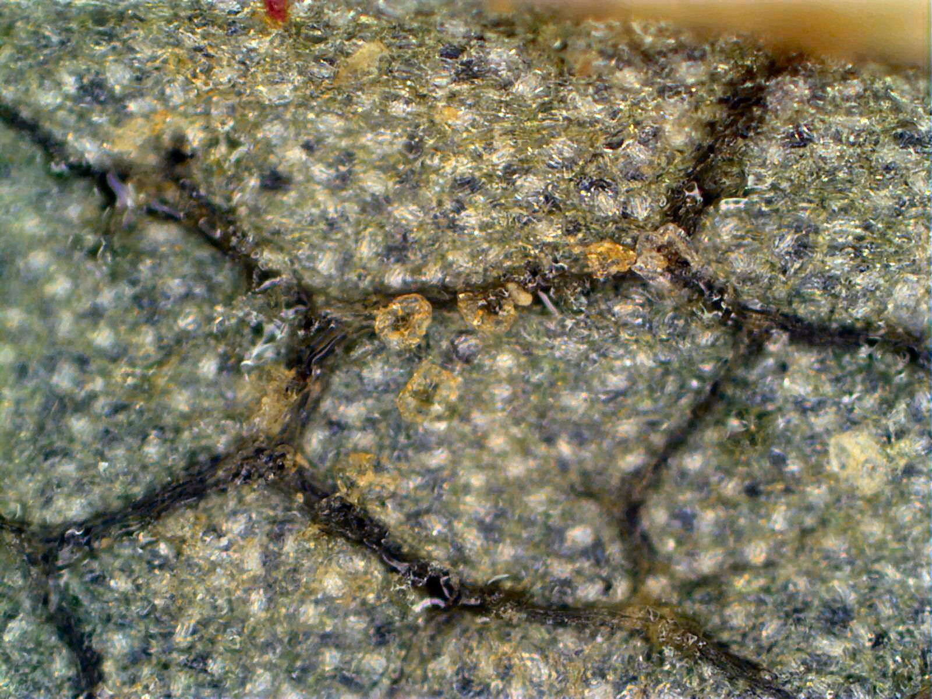
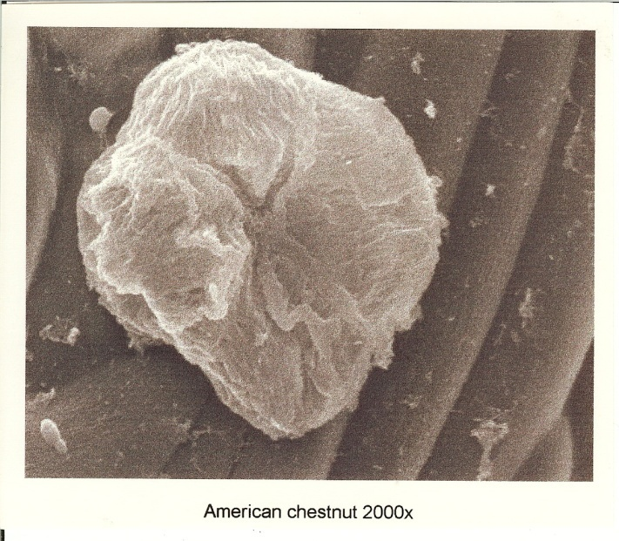
American chestnut
Underside of the leaf:
No hairs, besides a few on veins
4-celled glandular hairs, called trichomes, on leaf surface
4-celled American trichomes have “hot cross bun” shape

Slide 6
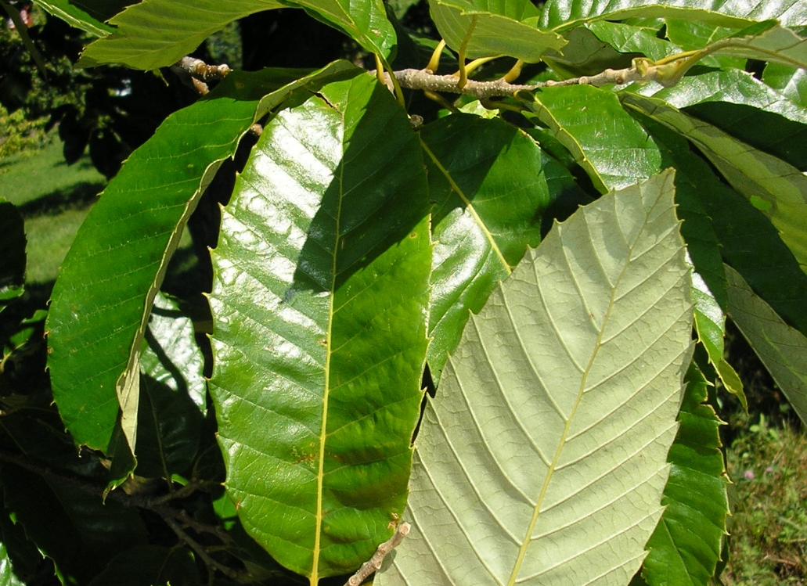
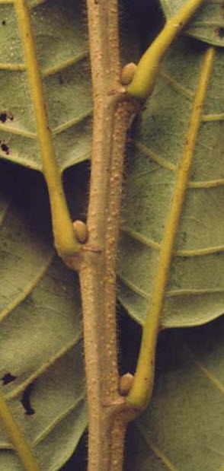
Chinese chestnut Spreading, orchard-form tree
Leaf glossy, usually hairy on underside
Leaf thick, may be leathery in texture
Leaf oval to row-boat shaped with wedge-toothed margins
Twig pea-green to tan, new growth hairy
Bud round, pea-green to tan, hairy and in-line with stem

Slide 7
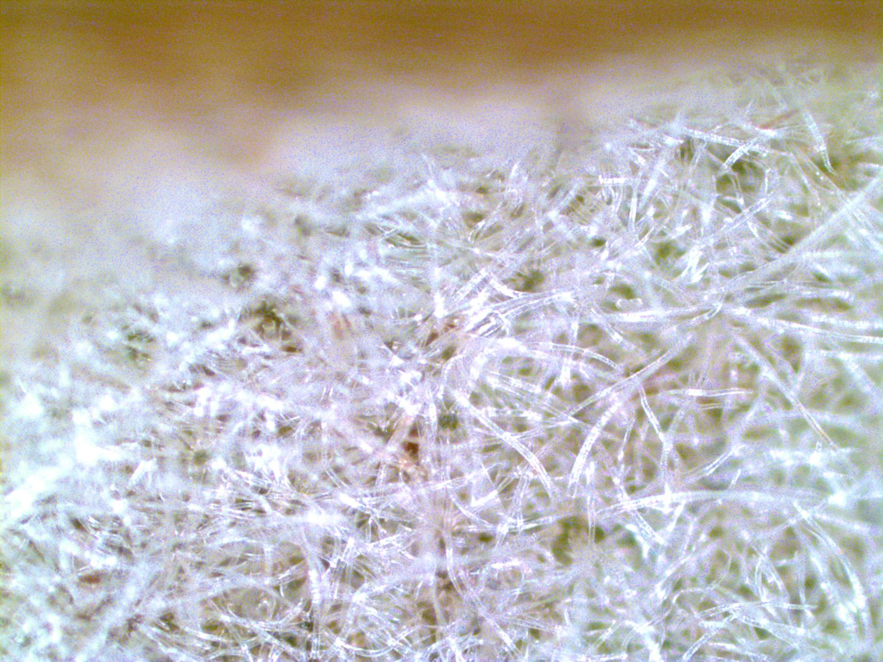
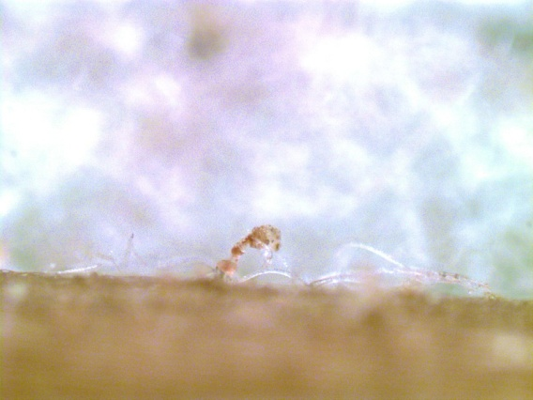
Chinese chestnut
Underside of the leaf:
Sun leaf very hairy – both stellate (star-shaped) and simple hairs
Stalked glandular hairs with prominent heads, (trichomes) on leaf veins only

Slide 8
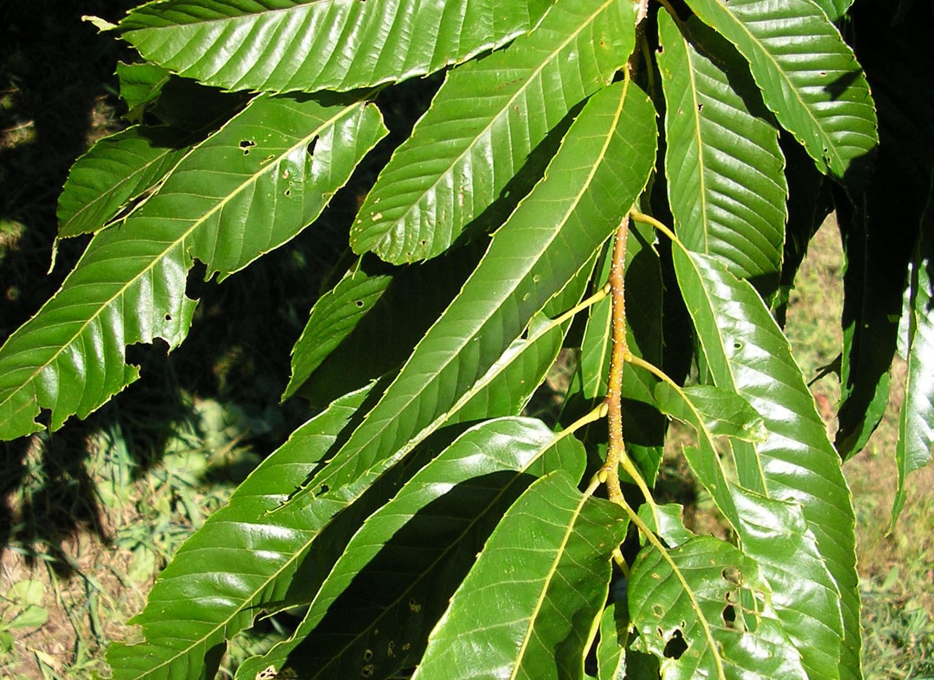
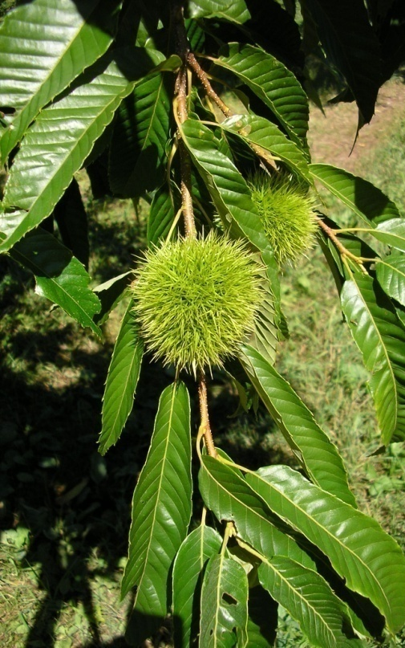
Japanese chestnut Spreading, orchard-form tree
Sun leaf glossy, hairy on underside
Leaf narrow, oval with blunt base
Bristle-toothed margins
Twig pinkish-brown, new growth hairy

Slide 9
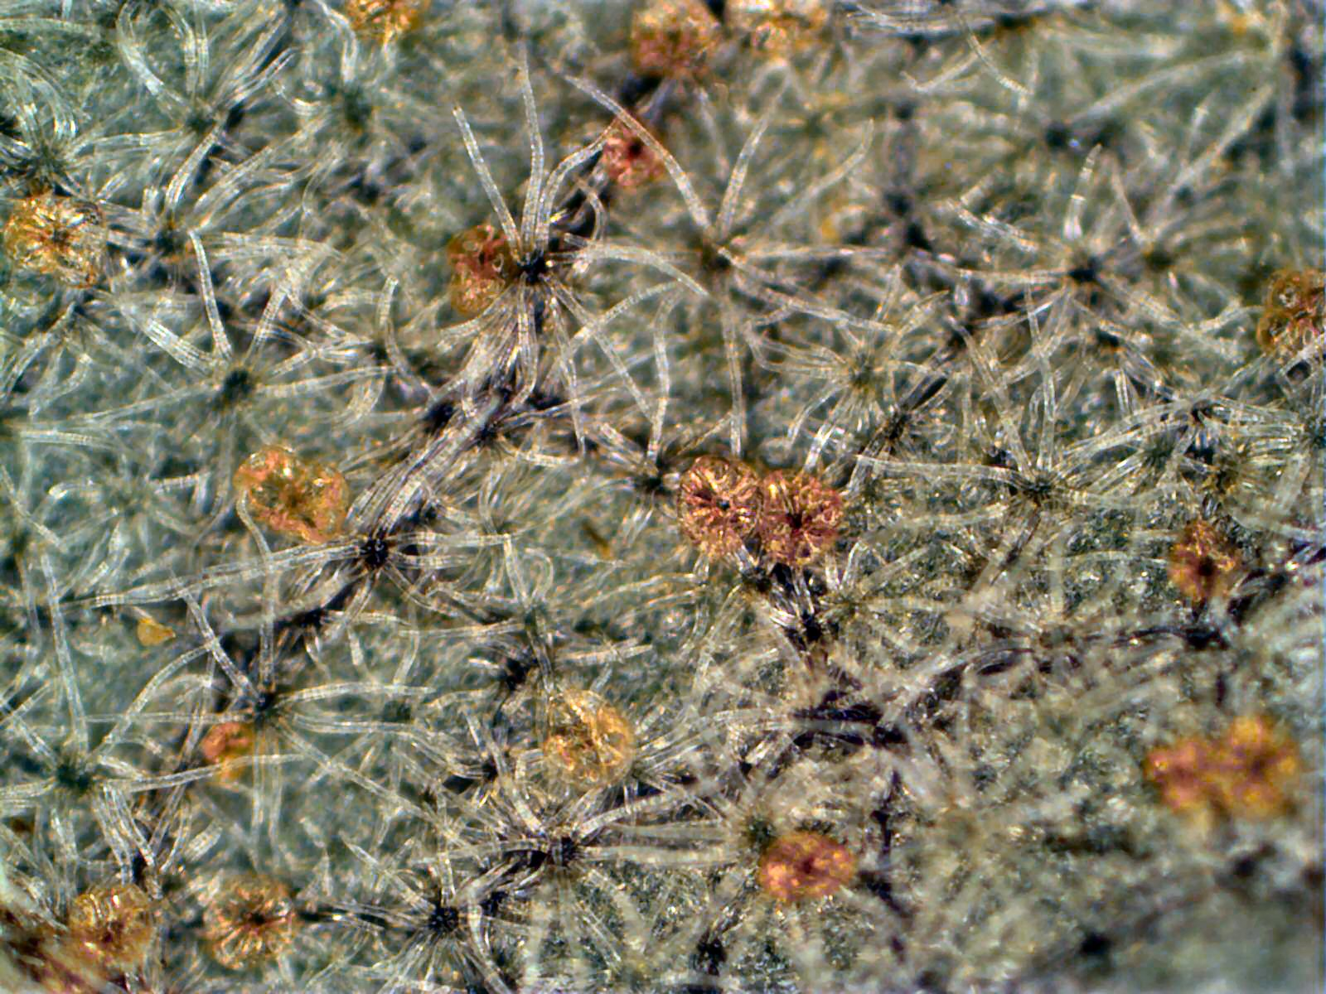
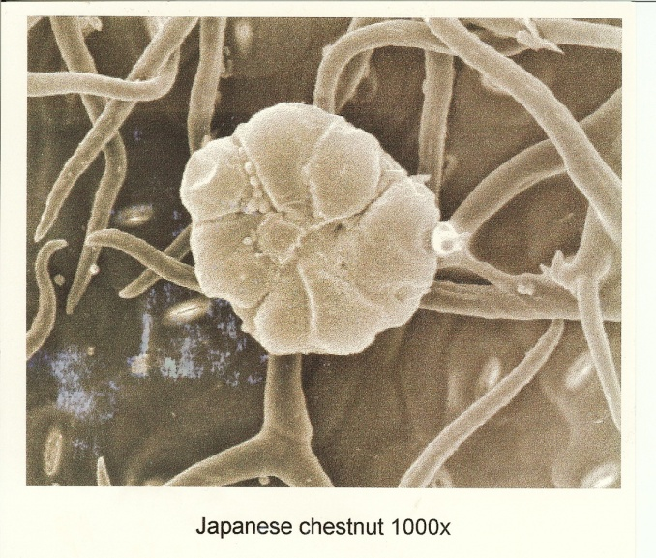
Japanese chestnut
Underside of the leaf:
Sun leaf hairy – both stellate (star-shaped) and simple hairs
9-celled glandular hairs (trichomes) on leaf surface
9-celled trichomes much larger than American trichomes

Slide 10
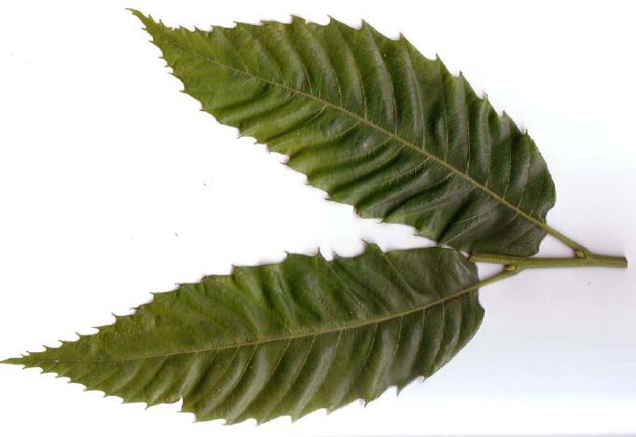
European chestnut Spreading, orchard-form tree
Leaf most similar to American, more triangular leaf margins
Leaf base often rounded, with a long petiole
Leaf underside may be hairy
Twig very thick and coarse, dark brown at maturity
Bud very large, may be reddish

Slide 11
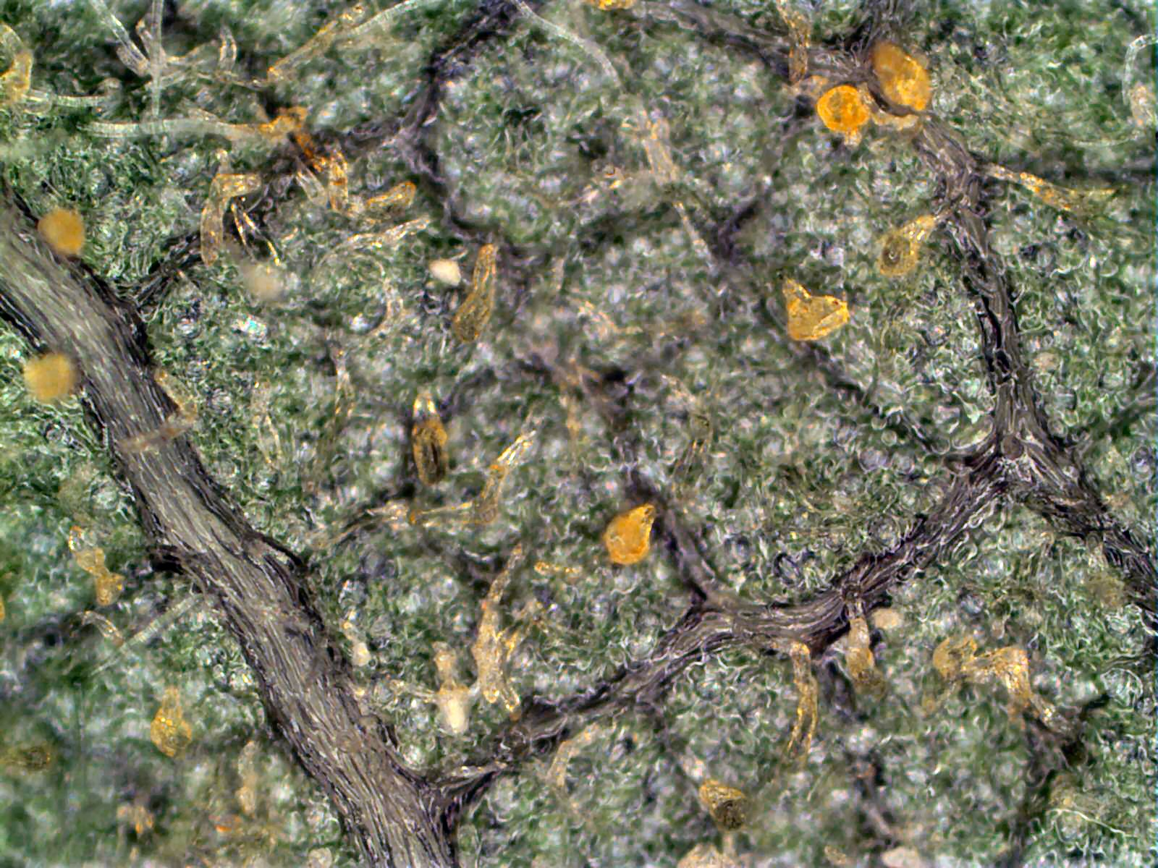
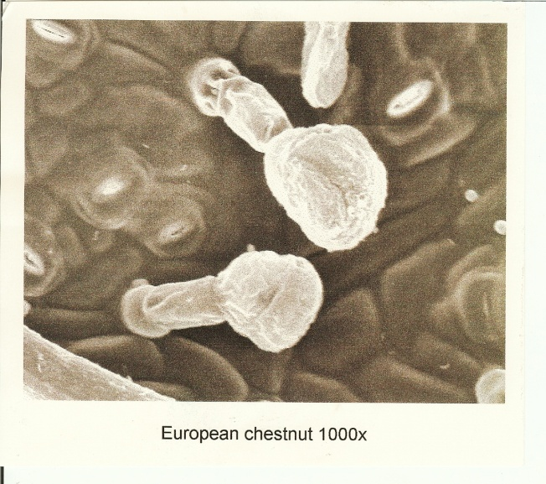
European chestnut
Underside of the leaf:
Vary between very hairy and not hairy
Stalked, club-shaped glandular hairs (trichomes) present, though often difficult to see
Stalked trichomes on leaf surface and leaf veins

Slide 12
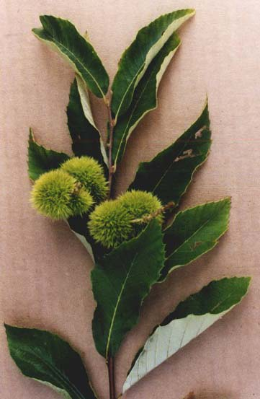
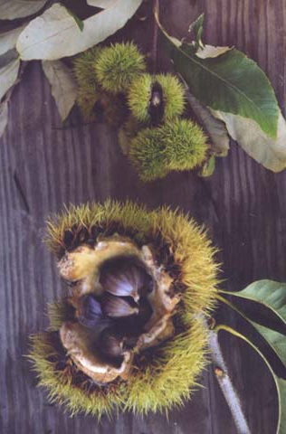
Allegheny chinquapin Shrub or small tree
Leaf usually hairy on underside
Leaf margins slightly to deeply toothed
One pointed nut per bur, instead of three
Burs form in clusters
Burs open in two parts, instead of four

Slide 13
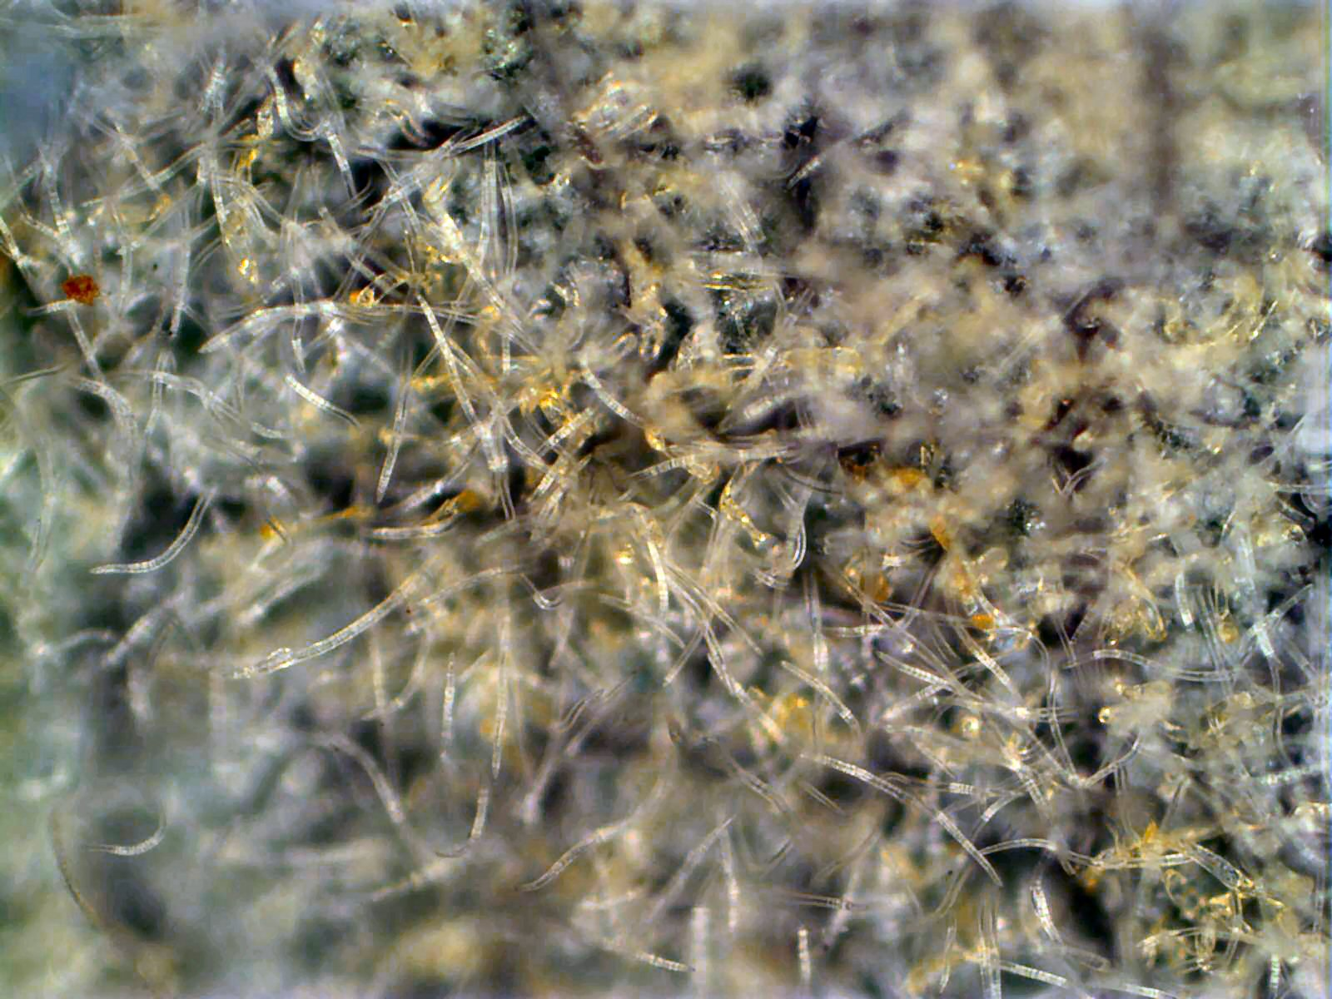
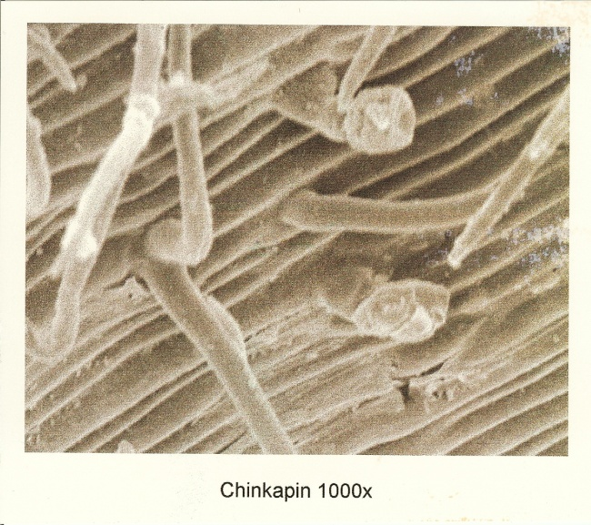
Allegheny chinquapin
Underside of the leaf:
Sun leaf usually very hairy
Both simple and stellate hairs
Bulbous glandular hairs (trichomes) on leaf surface

Slide 14
Species Comparisson
Top side of leaves:
Underside of leaves:
Top row: Allegheny chinquapin
Bottom row: American, Chinese, European and Japanese chestnuts

Slide 15
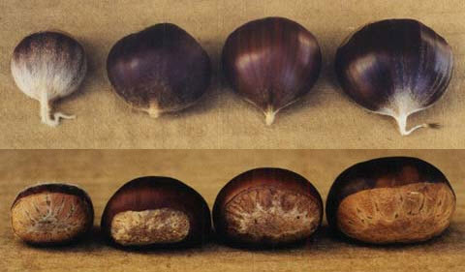
Species Comparison: Nuts
Top and Side Views of Chestnuts.
From Left: American, Chinese, Japanese, and European

Slide 16
Photo Credits
All microscopic images were taken/provided by Stephen Baumann, Tim Eck and Dave Armstrong
All SEM images were taken by Tracey Coulter, with support from the WISER grant program
Species comparison images, as well as Allegheny chinquapin images, were taken by Dr. Paul Sisco
The larger European chestnut image was taken by Dave Armstrong
All other images were taken by TACF staff
Thank you to all who provided images for this presentation!

